Slide 1
Brockport Calendar Assistant - Alexa Skill and Google Action
Collaboration with Paychex
Students: Zachary Tuttle, Andy Duong, Stefen Sharkey, Evan White
Mentoring Professor: Dr. Jerry Ajay
Paychex Mentor: Steve Bell
Notes:
Fix title

Slide 2


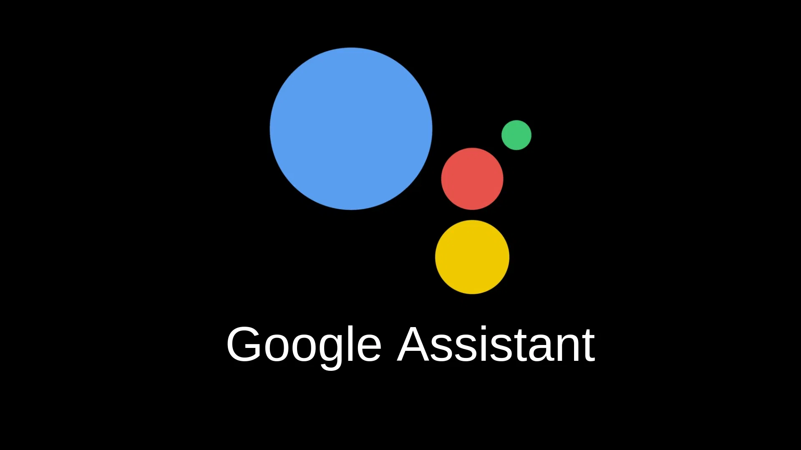
Outline
Intro
What is it?
Who’s it for?
Why build it?
Development
Approach
Technical highlights
Lessons learned
Work for future students
Demo
Q&A

Slide 3
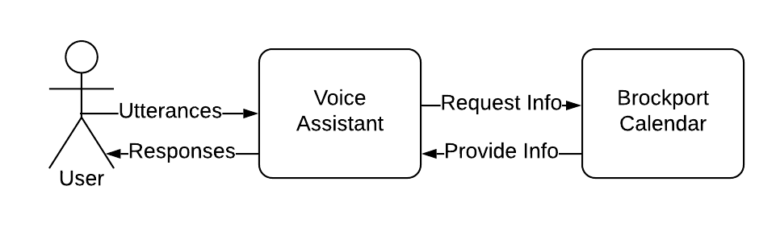
What Is It?
Voice assistant that allows users to access The College at Brockport academic schedule through conversation
Available through Amazon Alexa and Google Assistant
Users can:
Ask for upcoming events, specifying how many days to look forward (Google)
Ask what is happening on a given day.
Ask when a given event is happening
Ask how far away a given event is

Slide 4
Who’s It For?
Students
Students already have enough on their mind.
Why not make planning out their semester easier?
Makes it easy to figure out any important upcoming dates.
Faculty
Professors need this information as well.
Makes their job easier so they can focus on their work.
Family and friends of students
Interested in events like breaks, graduation, and awards ceremonies.
May not be familiar with how to access the calendar online.

Slide 5




Why Build it?
VOICE ASSISTANT TECHNOLOGY HAS BEEN GROWING RAPIDLY, AND MOST NEW DEVICES NOW COME EQUIPPED WITH IT IN ONE FORM OR ANOTHER
GOOGLE AND AMAZON PROVIDE POWERFUL, INTUITIVE RESOURCES FOR DEVELOPERS TO BUILD ON THEIR PLATFORMS
OBTAINING INFORMATION THROUGH CONVERSATION REQUIRES VERY LITTLE TECHNICAL KNOWLEDGE, MAKING THIS PRODUCT USEFUL TO PEOPLE OF ALL LEVELS OF TECHNICAL LITERACY
PROVIDES AN ACCESSIBLE WAY FOR PEOPLE WITH VARIOUS DISABILITIES TO ACCESS INFORMATION
Notes:
Subslide of intro

Slide 6
Approach
Functional Requirements:
Parsing Brockport’s academic calendar
Providing an event date from its name
Providing an event name from its date
Providing number of days until an upcoming event
Providing upcoming events
Non-Functional:
Parsing other academic calendars from other colleges

Slide 7
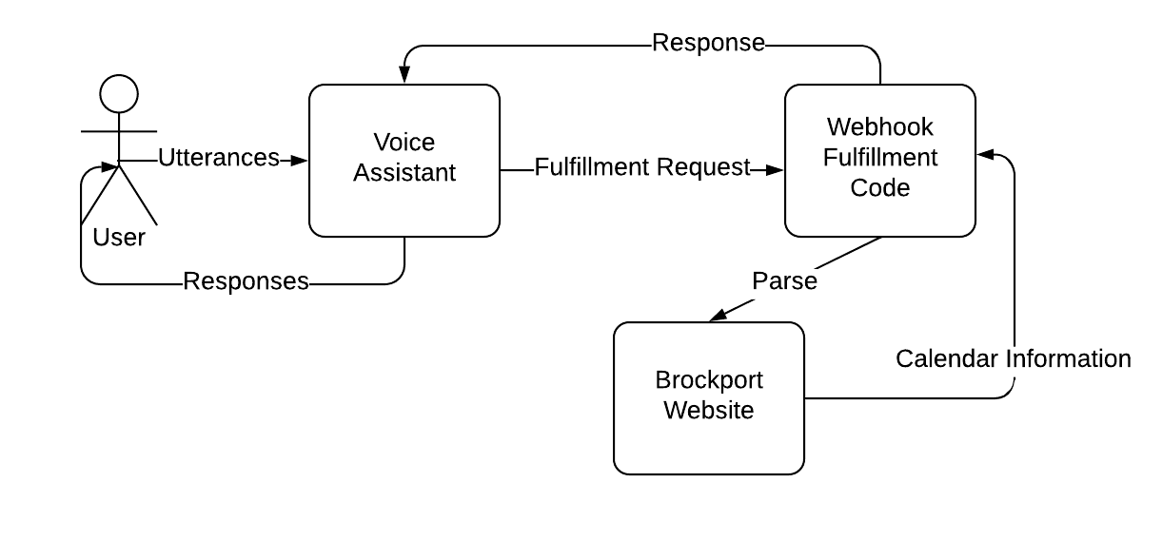
Architecture Diagram

Slide 8
Technical Highlights
Used Jsoup HTML parsing library to pull information from the Brockport website
Used Levenshtein distance algorithm for matching user queries to event names
Implemented with FuzzyWuzzy string matching library
Started with Simple Ratio
Switched to Weighted Ratio and found more accurate results
// Iterate through every key-value pair and compare the event name
// similarity to the event in the current loop state.
Date today = new Date();
CALENDAR.forEach((currEventName, date) -> {
// Remove all non-alphanumeric characters from the current
// event.
String tempEvent =
currEventName.toLowerCase().replaceAll("[^a-z0-9]", "");
// If we are looking at past events or if the event has not
// yet occurred, insert the date.
if (tense == Tense.PAST || !date.before(today)) {
insertDate(
new DateInfo(cleanEventNames ?
getCleanEventName(currEventName) :
currEventName,
date,
tempEvent.contains(finalEventName) ?
100 :
FuzzySearch
.weightedRatio(finalEventName, tempEvent)));
}
});
Notes:
remove database picture
show diagrams here possibly

Slide 9
Technical Highlights (cont’d)
Calendar on website can be changed at any moment without warning
Decided against storing information in database
Instead, a Map is populated with Event-Date pairs upon invocation
Ensures information is up-to-date with current calendar
dateList.forEach(date -> {
String eventName = events.get(x[0]).text();
if (CALENDAR.containsKey(eventName)) {
String duplicate = eventName + " Day 2";
for (int y = 2;
CALENDAR.containsKey(
duplicate.substring(0, duplicate.length() - 1) +
y);
y++) {
duplicate =
duplicate.substring(0, duplicate.length() - 1) +
(y + 1);
}
eventName = duplicate;
}
CALENDAR.put(eventName, date);
});
Notes:
Objective - code base shared between alexa and google
use diagram that facilitates these descriptions

Slide 10
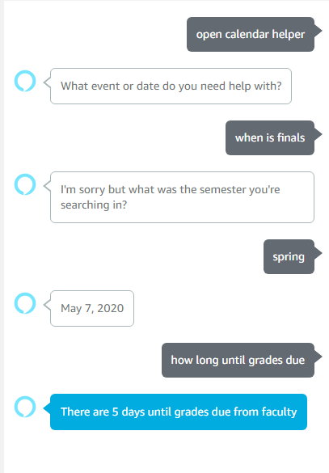
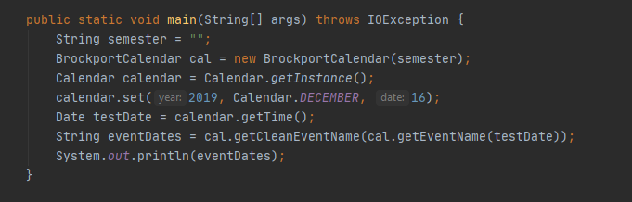
Lessons Learned (Amazon Alexa)
Testing
We noticed the importance of unit testing because we had to do exhaustive testing
Documentation
good documentation when available made for easier code transference
Debugging
There wasn’t a good environment to optimally debug in
Notes:
have outline for lessons learned

Slide 11
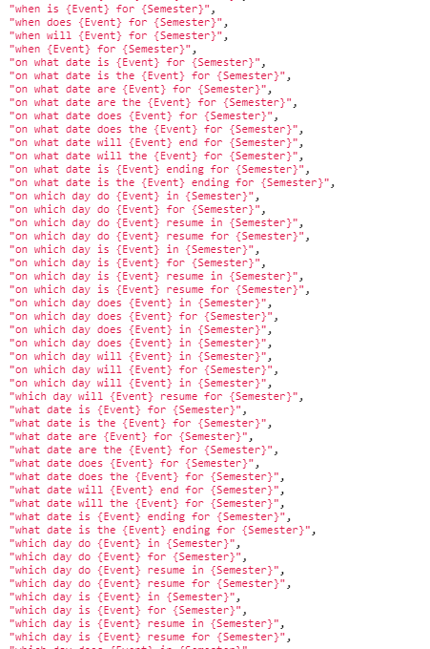
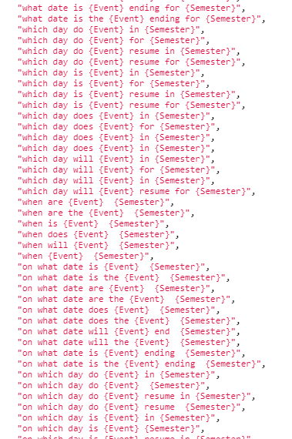
Lessons Learned (Amazon Alexa)
Coding issues
Problems arose when drifting from the main introduction code.
Documentation for this was almost non-existent or buried in stackoverflow
Utterance samples
We did not realize how many utterances would be necessary for exhaustive testing.

Slide 12
Lessons Learned (Google Assistant)
String response =
"You asked about how many days there are until " +
eventName + ".\n";
if (dateInfo == null) {
response += "There were no events found.";
} else {
int days = (int) LocalDate.now()
.until(dateInfo
.getDate()
.toInstant()
.atZone(ZoneId.systemDefault())
.toLocalDate(),
ChronoUnit.DAYS);
response += "There are " + days + " days until " +
dateInfo.getName() + ".";
}
DialogFlow
Did not hide unnecessary features
Provided term highlighting and classification
Many examples online
Natural language processing
Major pitfall: getting new intents to work consistently
No coherent set of instructions
Notes:
Chinese character has to go
simply some of the more detailed technical information, if not make it into a picture? (somehow)

Slide 13
Shared Lessons Learned
Fortunate to accomplish our research and documentation in-person
Moving online, development was manageable
Tools like Trello to help organize and manage workflow
Keeping user stories in mind kept development focused
Notes:
fix spacing issue here make it easier to read if we’re including all of the points above

Slide 14

Work for Future Students
With this project we provided a base upon which future students can add
Examples of possible features
Allowing professors to add their own custom events
Working with the school to build a repository of event names designed for speech, not reading
Adding other colleges to choose from

Slide 15
Demo
Get Event
What is happening on May 15th?
Was anything happening on September 26th, 2019?
Get Date (Amazon)
When are finals for spring/fall?
When is scholars day for spring?
Get Date (Google)
When was there a reading day?
When were midterms?
Get Days Until Event
How many days until final grades are due?
How many days until the first day of Summer Session?
Get Future Events
Show me upcoming events.
What’s happening in the next 7 days?
Notes:
include this in the notes section only for reference purposes

Slide 16
Q&A

